Slide 1

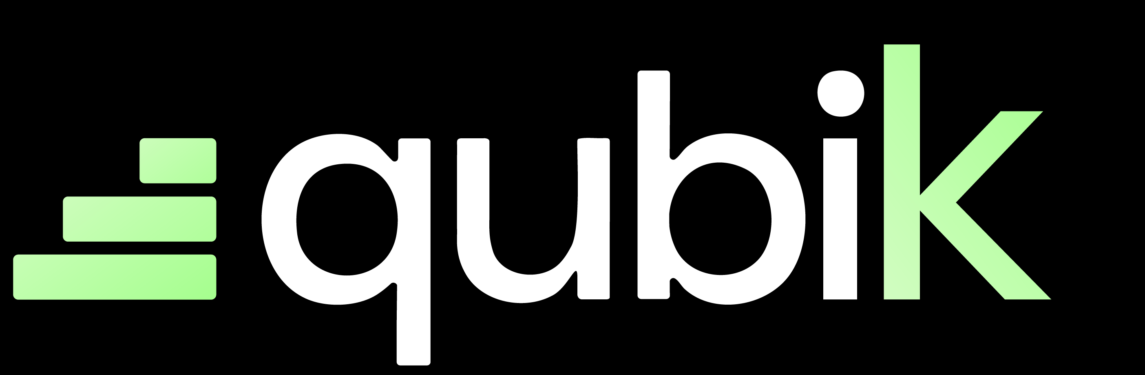


Slide 2
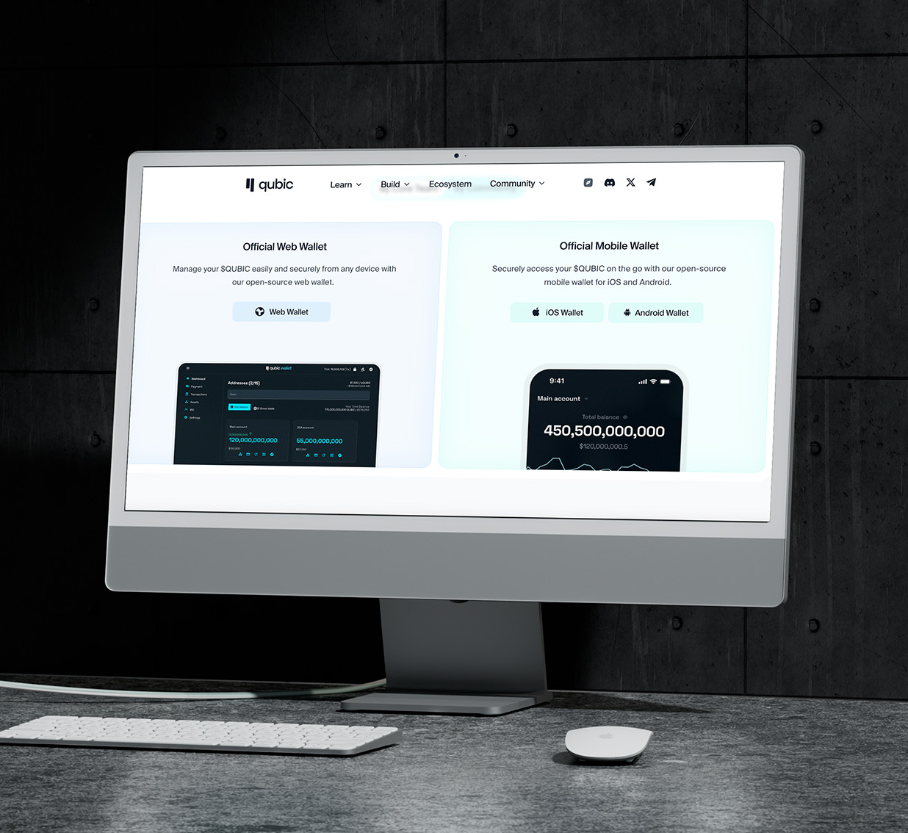
The problem
Qubic is amazing, but out of reach for most users.
The complexity of interacting with Qubic is blocking its growth.
Developers can’t easily integrate it into existing tools, and non-technical users are locked out.
Moreover, the Total Addressable Market in Qubic is still very tiny.

Slide 3
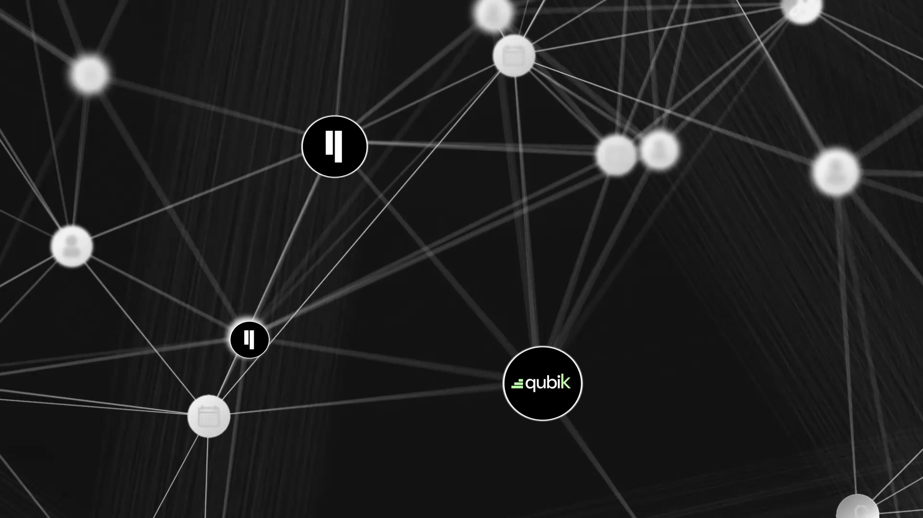
Our solutions.
QubiK is a native module for Make, the leading low-code automation platform.
It allows anyone to connect Qubic to real-world applications — in minutes, and without code.

Slide 4

Why Make?
Trusted by 1M+ users. Integrated with 1,600+ apps.
Make is the “glue of the Internet”, with an intuitive drag-and-drop interface.
It democratizes automation for users at all technical levels — at a lower cost than Zapier.

Slide 5
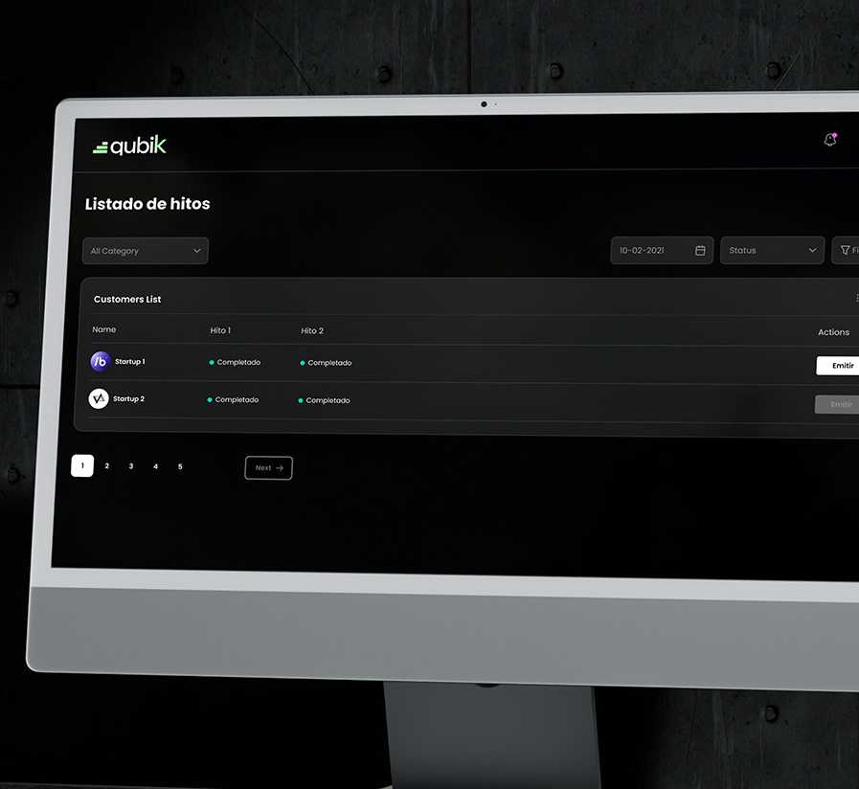
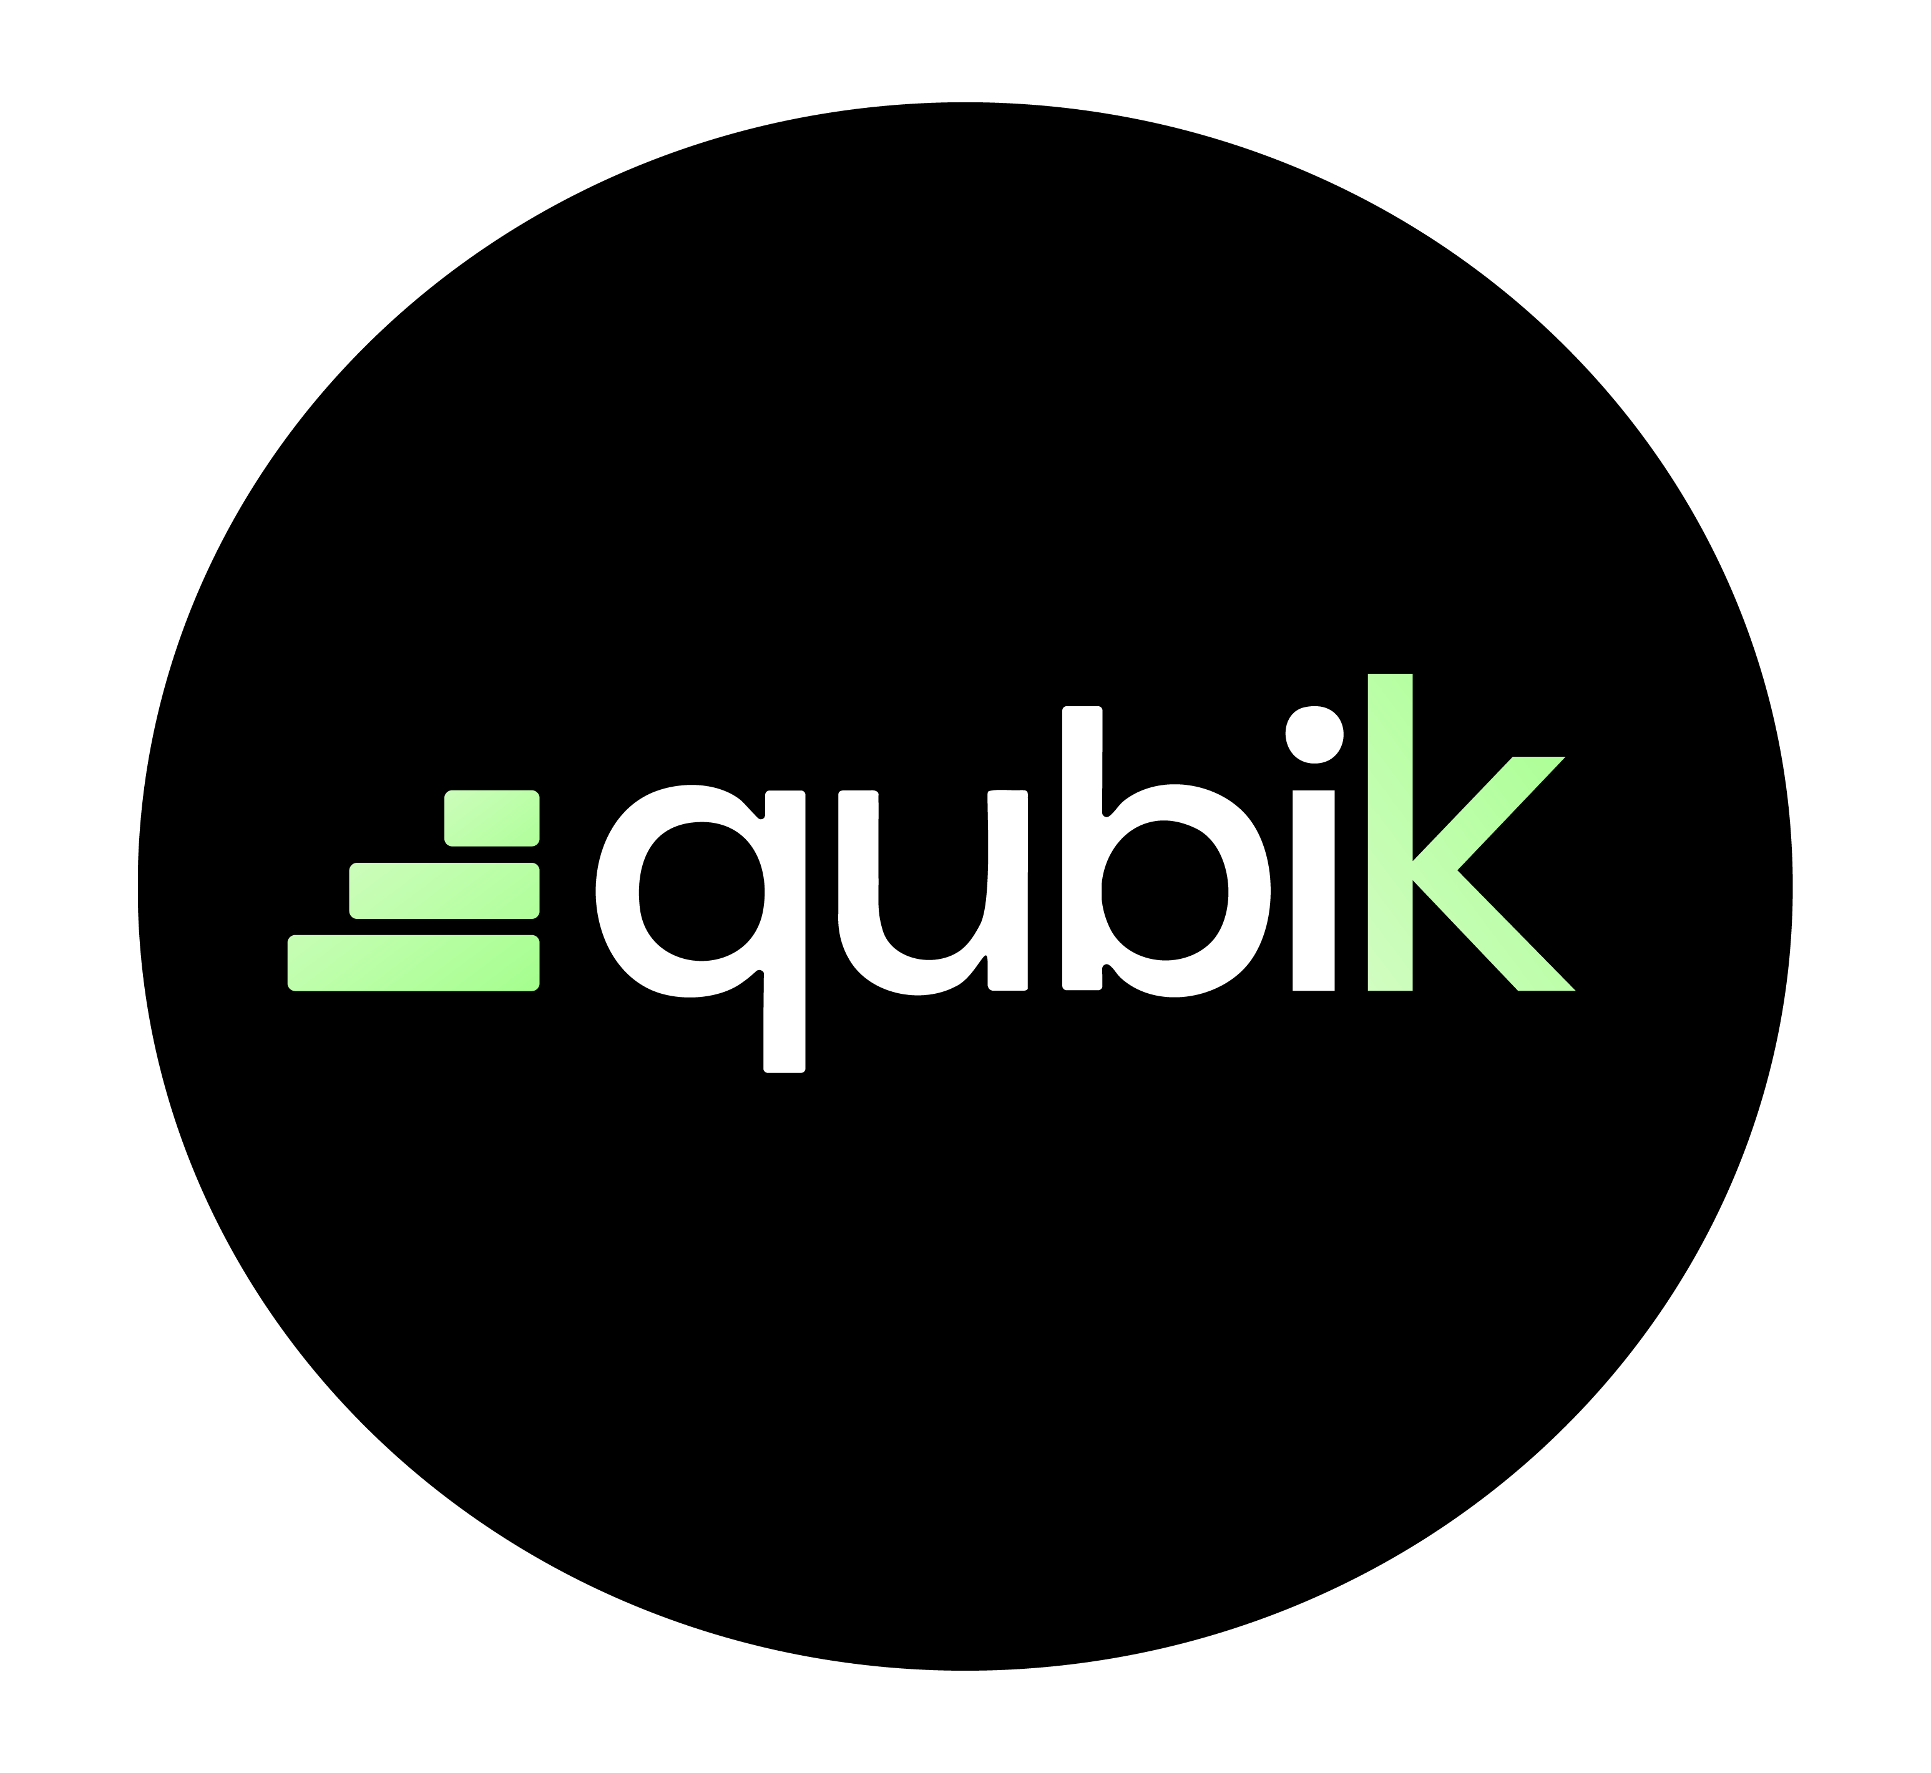
QubiK in Action
Uses case:
From blockchain to business — instantly.
- Monitor Qubic transactions and trigger workflows
- Send alerts, emails, or notifications
- Sync data with Google Sheets, CRMs or dashboards
- Integrate with AI and external oracles

Slide 6
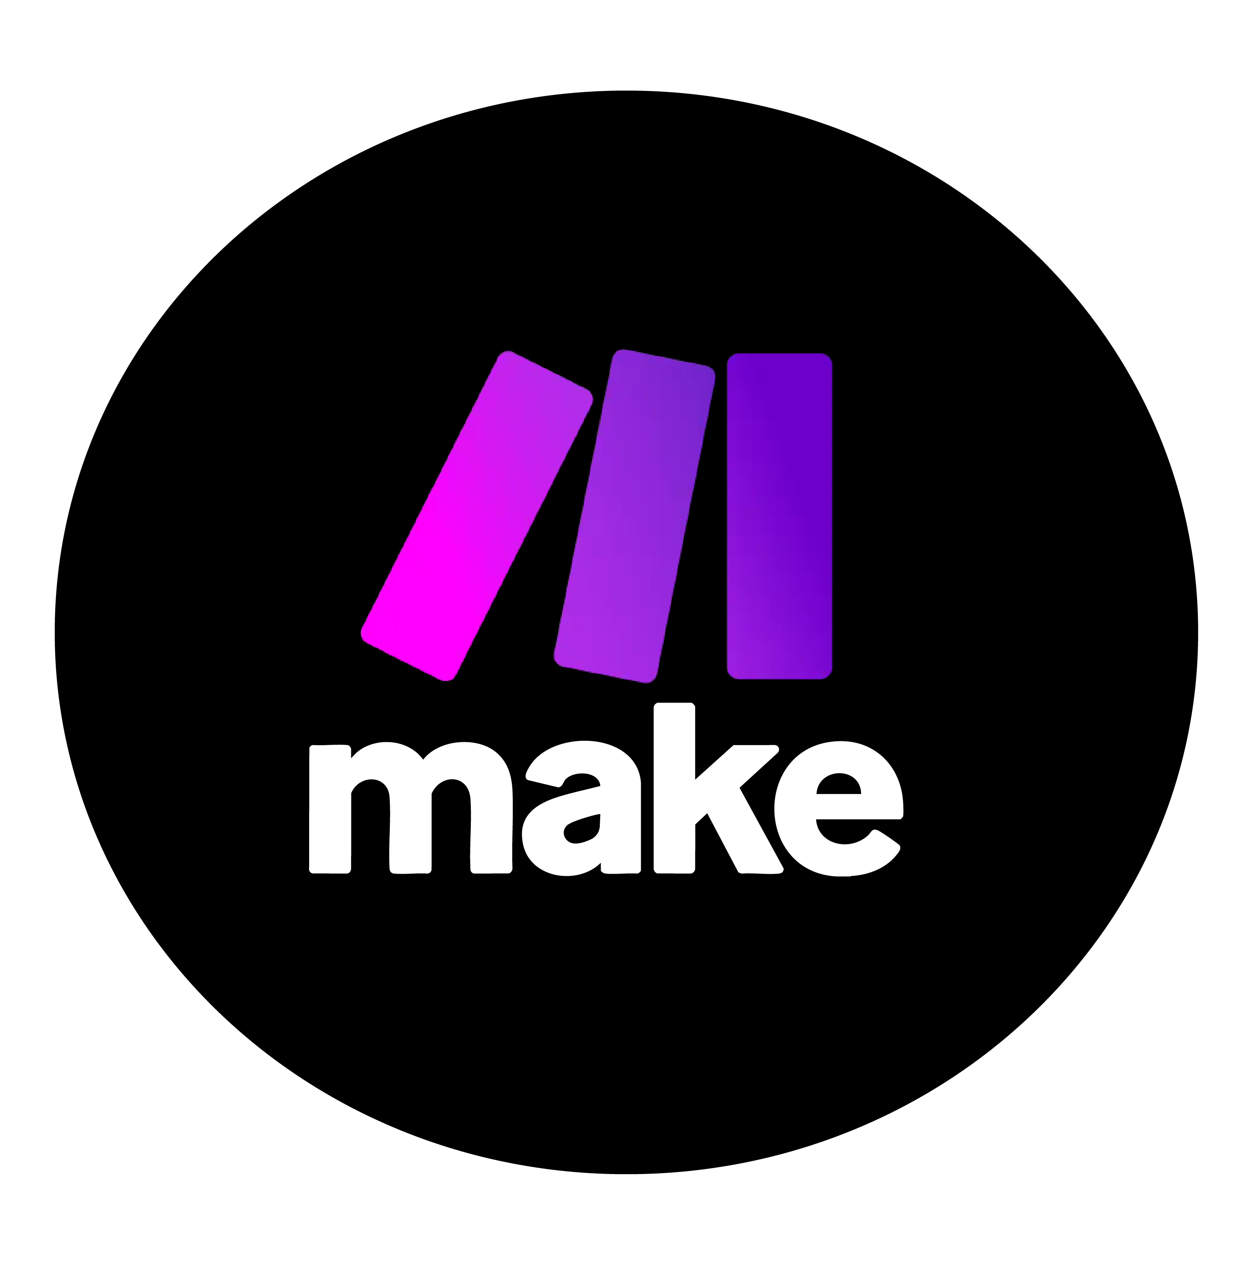

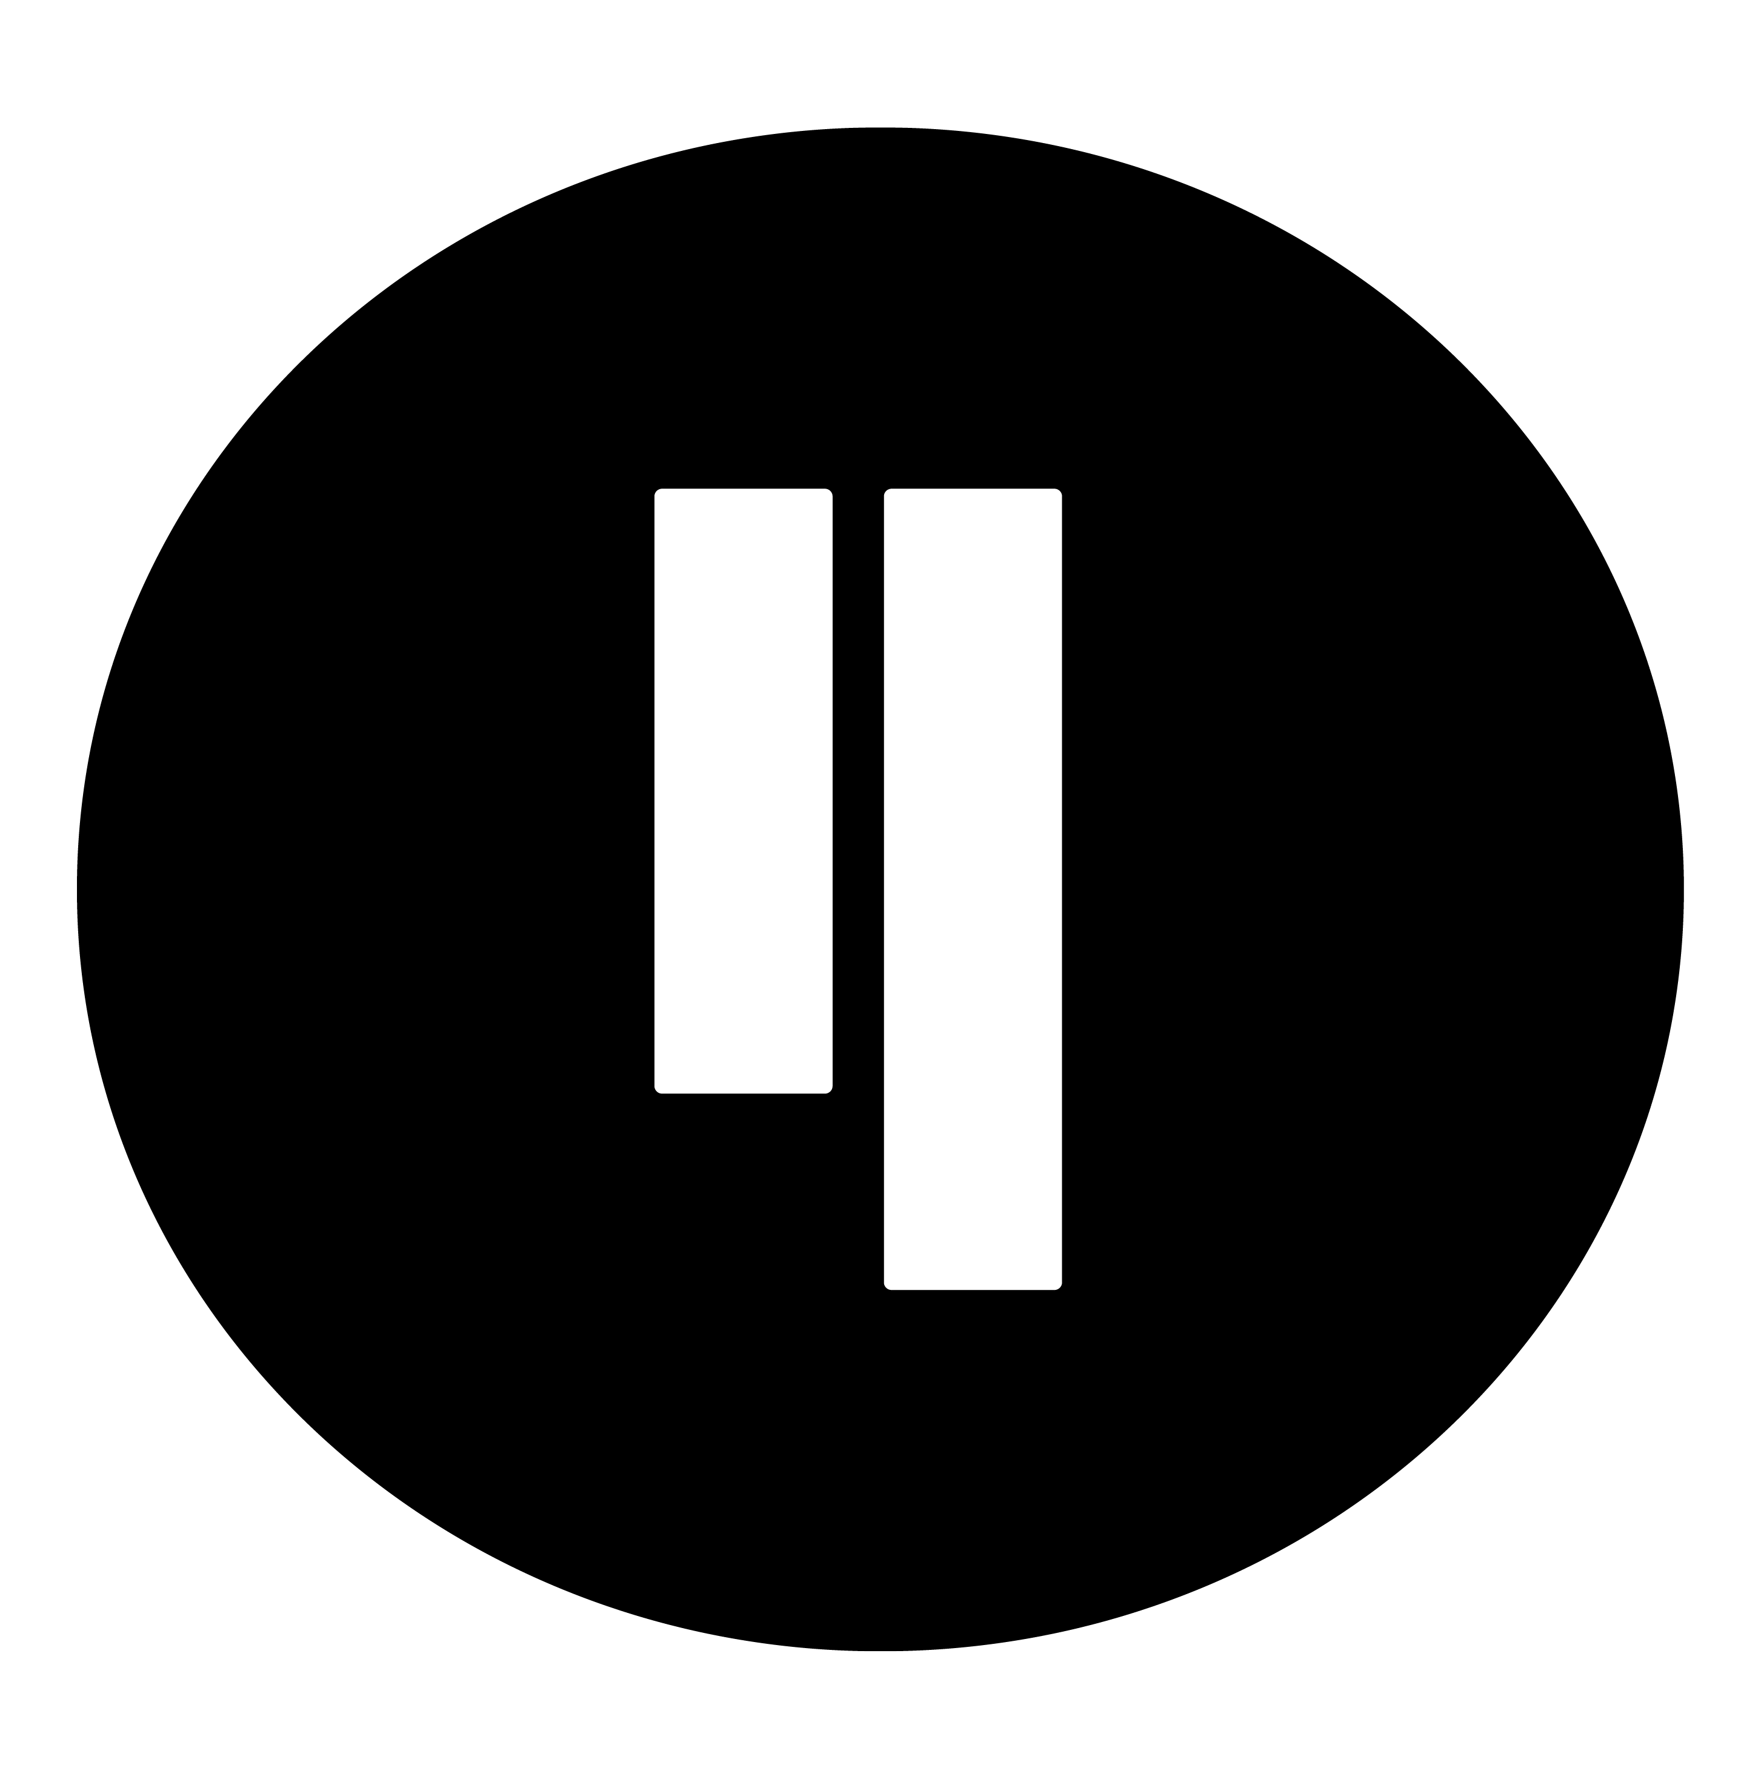
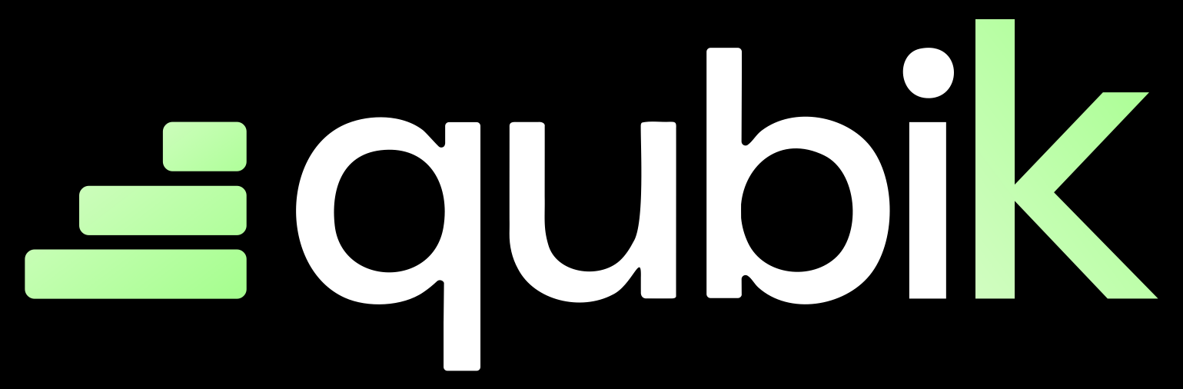
Business Plan
3,000,000
Freemium to scale. Premium to grow.
• Free tier: 1,000 ops/mo · 2 active scenarios · 15 min interval
• Premium tiers: Extended usage, advanced features & priority support
users
1000
users

Slide 7
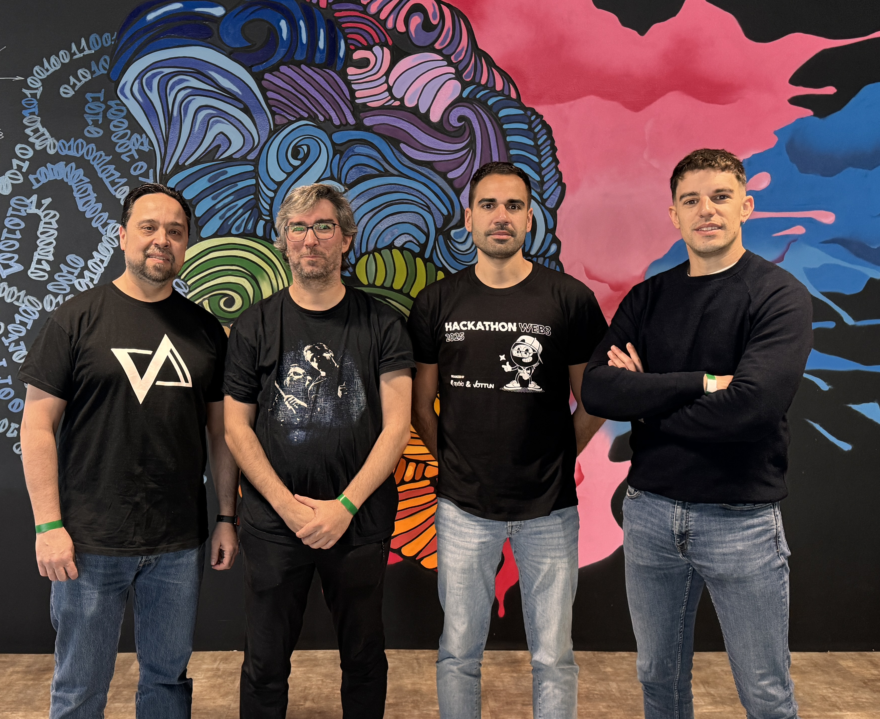
Nevtrace team
10 years building with blockchain.
At NevTrace, we help businesses unlock blockchain potential and scale onchain projects beyond early adopters.
QubiK is our answer to Qubic’s real-world adoption challenge.

Slide 8

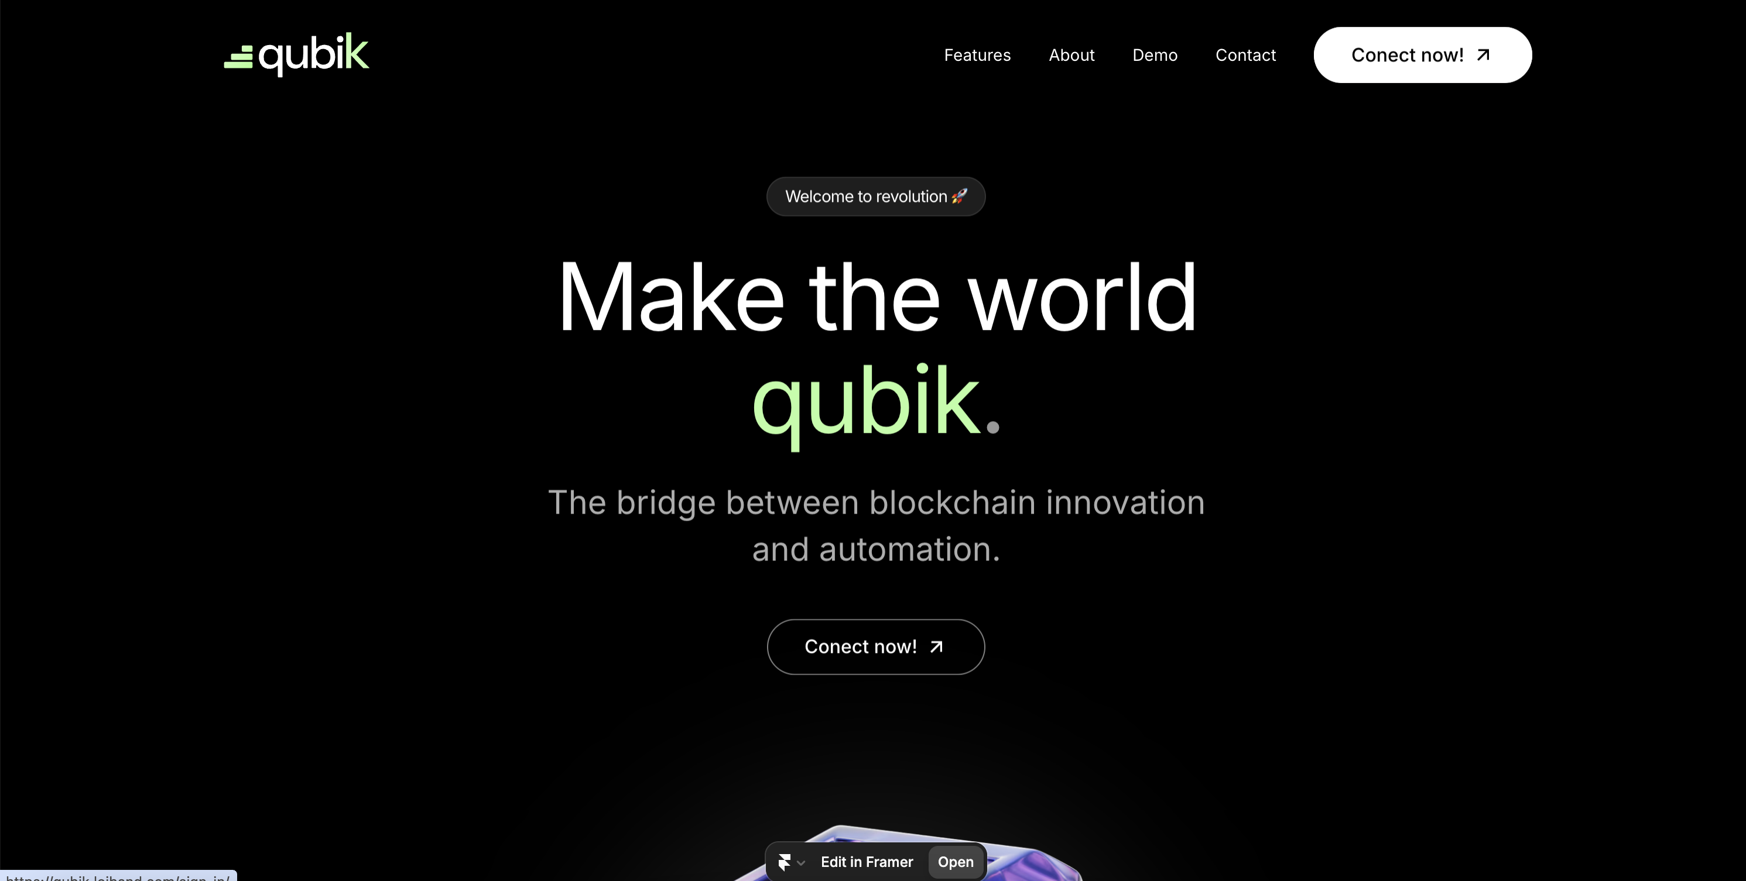
Let’s make the world qubiK.
QubiK bridges Qubic with the world — no code, no friction, no limits.
Join us in scaling one of the fastest and most powerful blockchains out there.

Slide 9
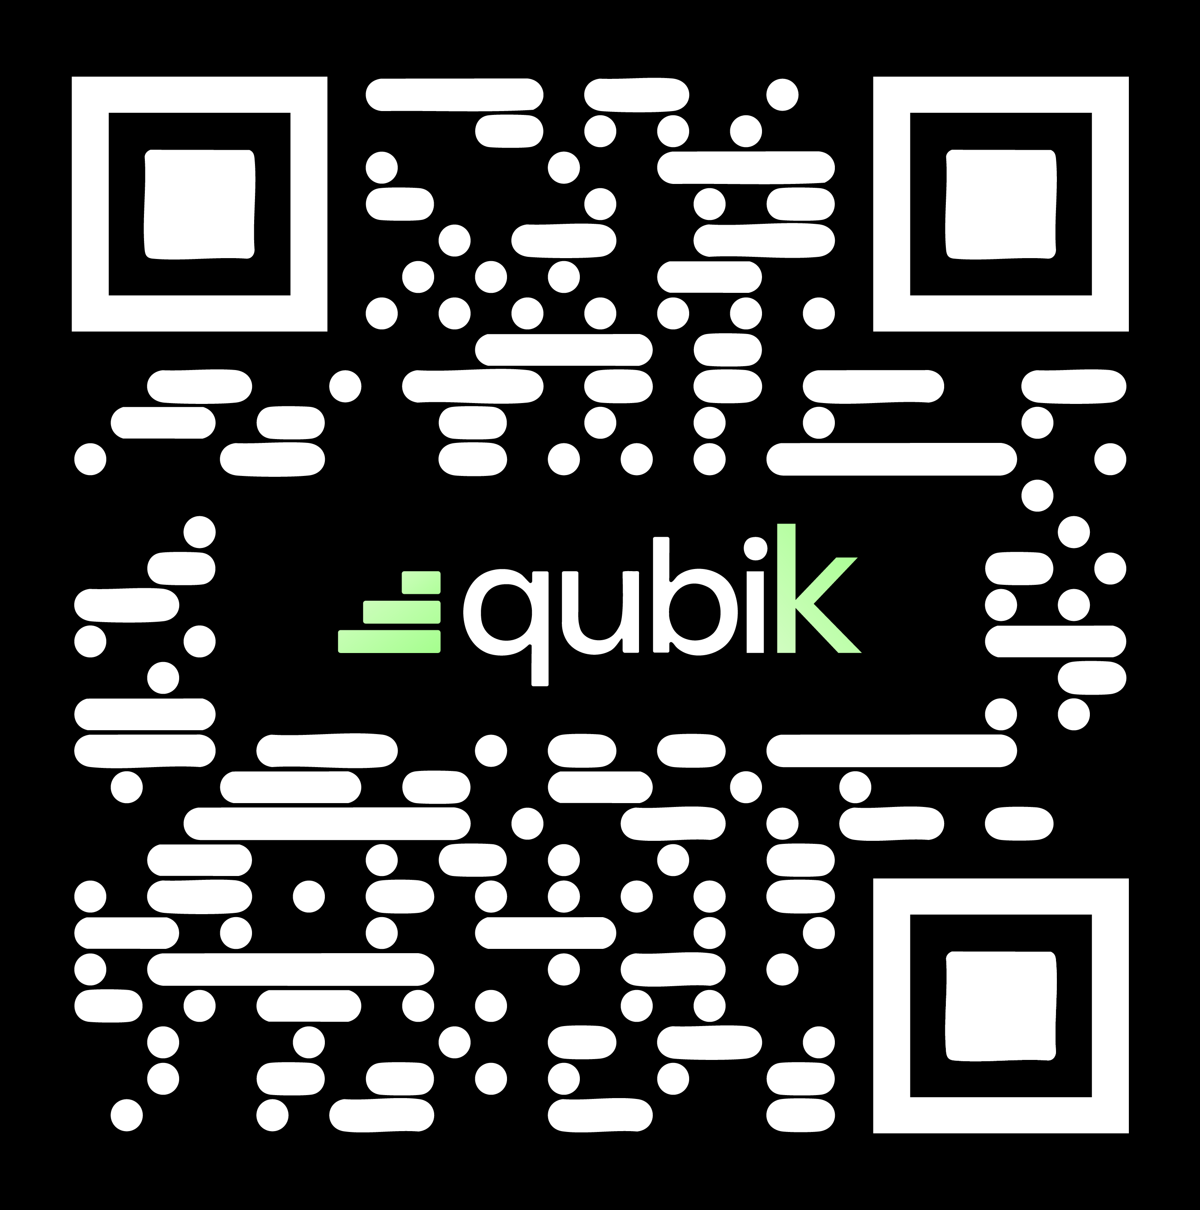
NFT MARKETPLACE
THANK YOU
This is just the beginning of something very QubiK.

